Slide 1
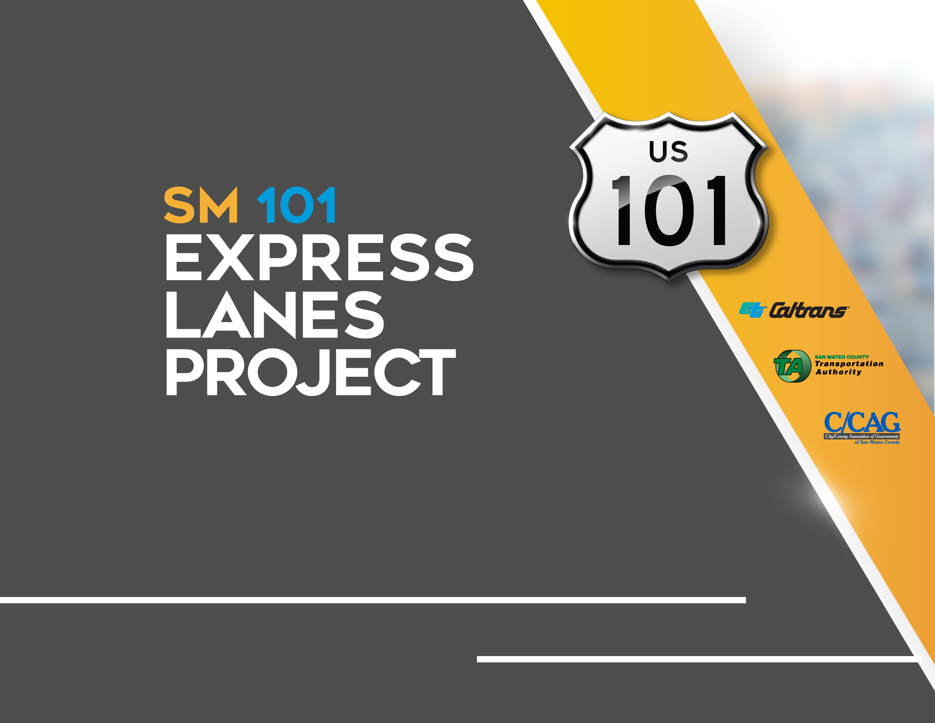
Quarterly Project Update
SMCEL-JPA Board Meeting November 12, 2021

Slide 2
AGENDA
  Construction Progress
  Project Spotlight
  Public Outreach Activities
  Financial and Risk Status

Slide 3
  Construction Progress
  Project Spotlight
  Public Outreach Activities
  Financial and Risk Status

Slide 4
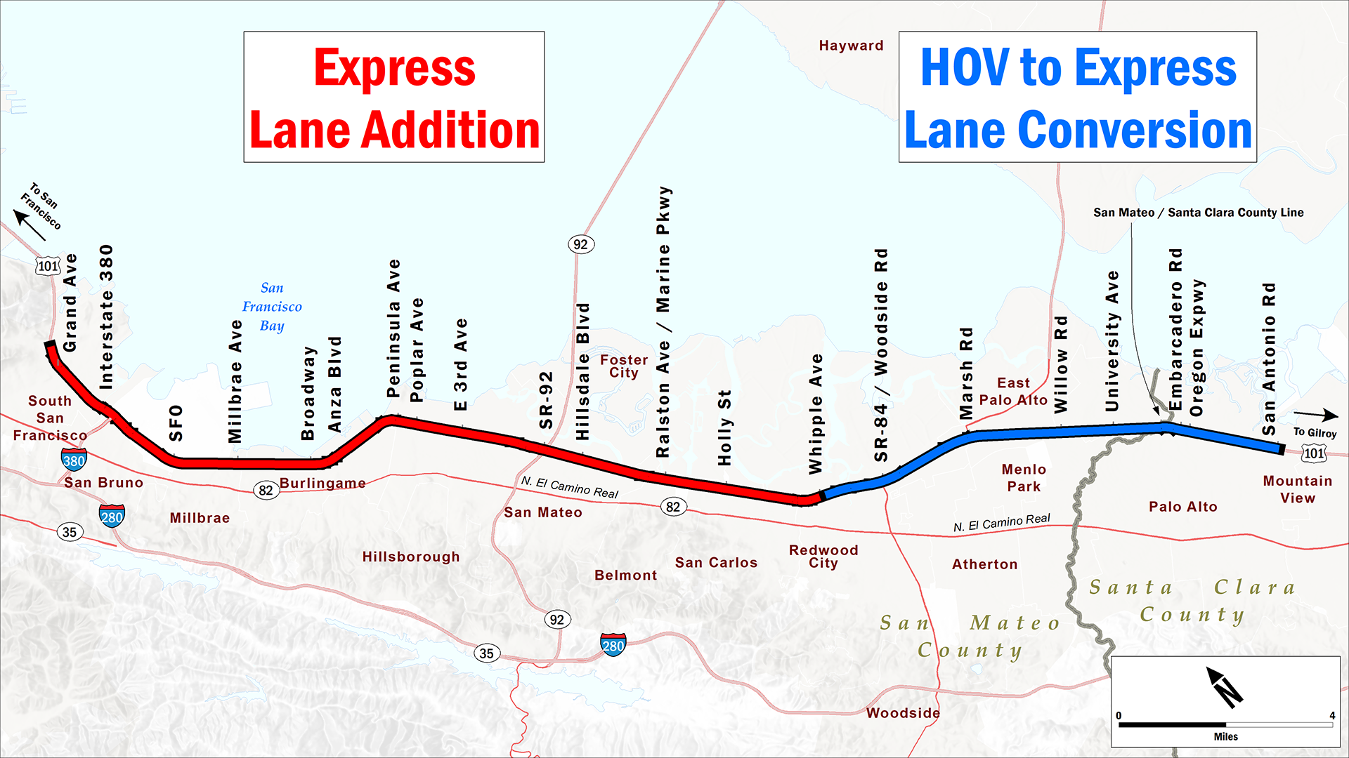
PROJECT LIMITS
Notes:
The SM101 project includes building a new express lane on the northern half, and converting the existing HOV lane in the southern half.

Slide 5
PROJECT SCHEDULE
Express
Lane
Addition
Begin Toll System
Installation
Summer 2021
Begin Toll Systems Testing
Summer 2022
Begin Tolling
Late 2022
North of
Whipple
2020
2021
2022
South of
Whipple
Begin Tolling
Late 2021
Begin Tolling
January 28, 2022
Begin Toll System Installation
Fall 2020
Begin Toll Systems Testing
Fall 2021
HOV to
Express Lane
Conversion
Notes:
The northern and southern sections will both be built and launched at different times. On both sides though, there are 3 main tasks: construction, toll systems installation, and opening the lane.

Slide 6

EXPRESS LANE OPENING DATE ADJUSTED
  Factors contributing to Schedule Adjustment:
  Supply Chain disruption
  COVID
  Weather
  Retesting
  Syncing opening with VTA
  Rationale for new Target Date of January 28, 2022:
  Avoid holiday season
  Work around weather delays
  Streamline testing process

Slide 7
OPENING DATE RISK MITIGATION
Risks to January 28 Opening Date |  | Risk Mitigations
Syncing start of tolling with VTA |  | Communicate regularly with VTA
Weather |  | Accounted for weather days in the schedule
COVID |  | TransCore validating that crews are following COVID protocols
Software development |  | TransCore deploying two teams to work on software development
Retesting |  | Streamlining testing process
Equipment failure and/or malfunction |  | Making use of North Segment equipment when it arrives
Supply chain |  | Making use of North Segment equipment when it arrives
  Note: not anticipated to affect North Segment schedule

Slide 8
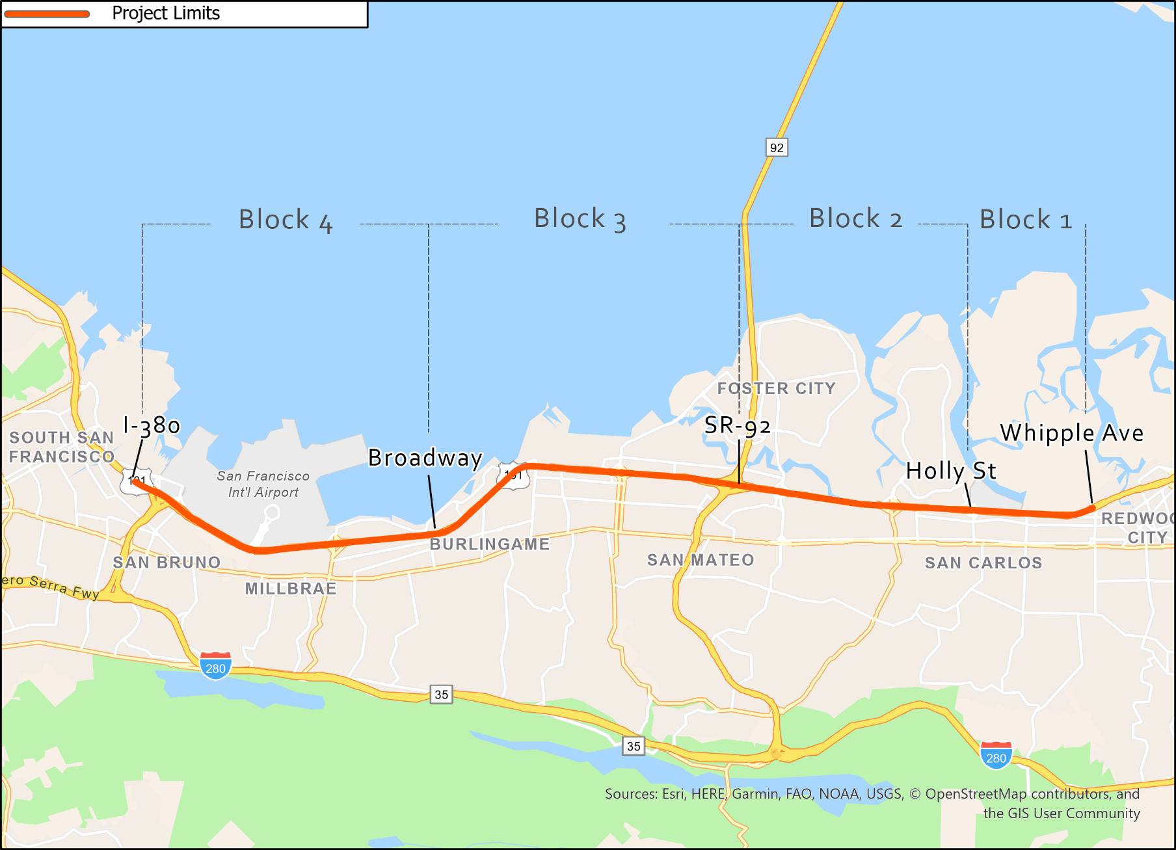
NORTH CONTRACT CONSTRUCTION BLOCKS
Paving underway
Paving underway

Slide 9
NORTH CONTRACT WORK COMPLETED
  North of Whipple through September:
  $254.28M of $326M completed (78%) with 63% time elapsed. 71% of paving complete.
  Completed sign foundations in Blocks 1, 2, and 3
  Completed installation of lights and sign structures in Blocks 1 and 4
  Completed restriping in Block 1 in preparation for final layer of paving
  Removed 2,000 linear feet of temporary barrier (in Blocks 1 and 4)
  Constructed approximately 15 miles of new median concrete barrier

Slide 10
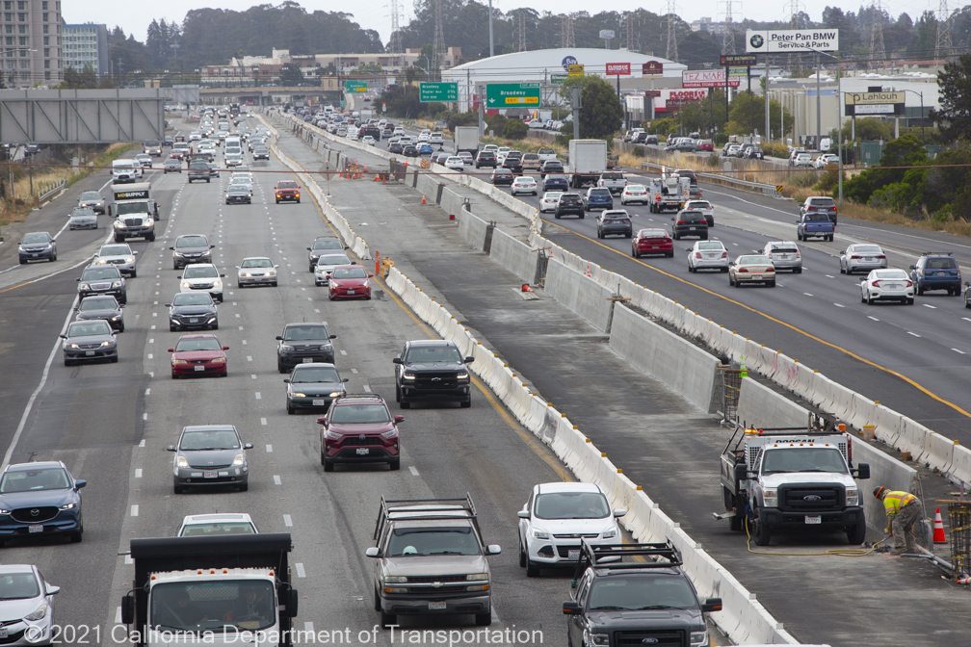
NORTH CONTRACT WORK ONGOING
Block 4 Median Barrier Construction

Slide 11
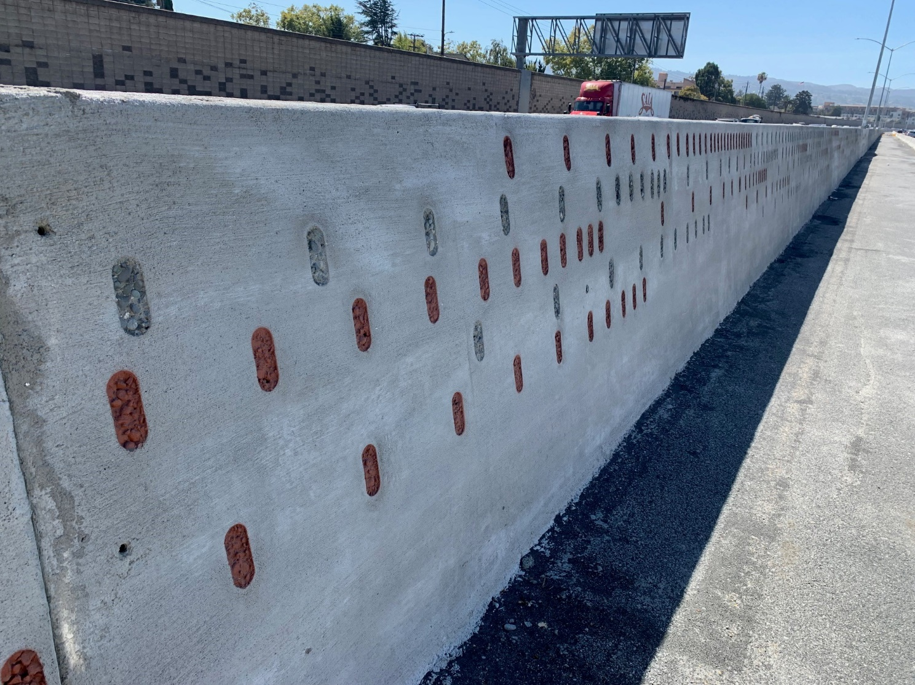
NORTH CONTRACT WORK ONGOING
Median Barrier Texture and Paint
Notes:
Caltrans Landscape Architecture: The design of this aesthetic patterning was inspired by the history of computing innovation in Silicon Valley (i.e. the binary punch cards Doug mentions), but it also reflects the aspirations of the new express lanes: accelerating speeds. The patterns appear to race forward along-side traffic, creating a sense of movement and speed. The design also plays off the gradients and colors in the new sound walls for a cohesive corridor aesthetic. We named the pattern in the barriers “Binary Hyperdrive”.

Slide 12
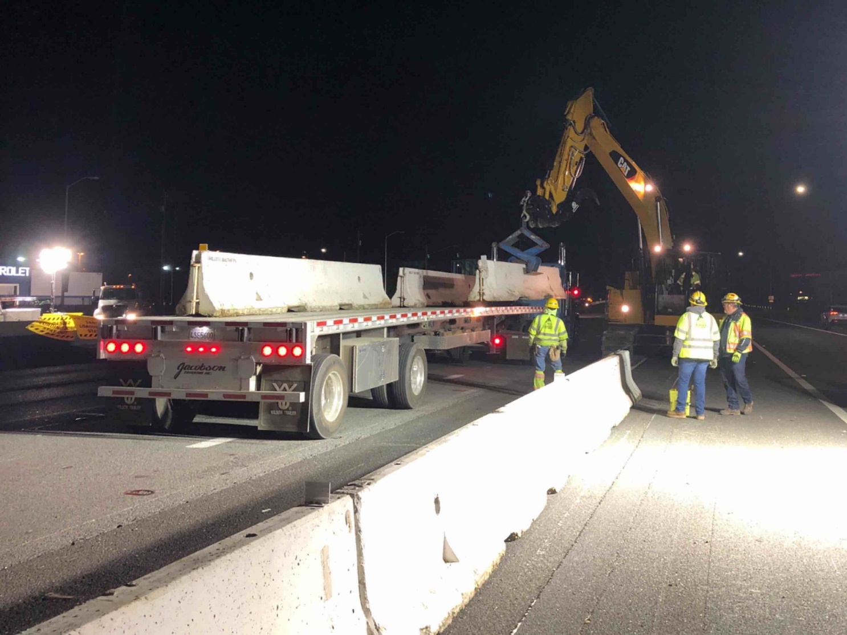
NORTH CONTRACT WORK ONGOING
Temporary Concrete Barrier Removal

Slide 13
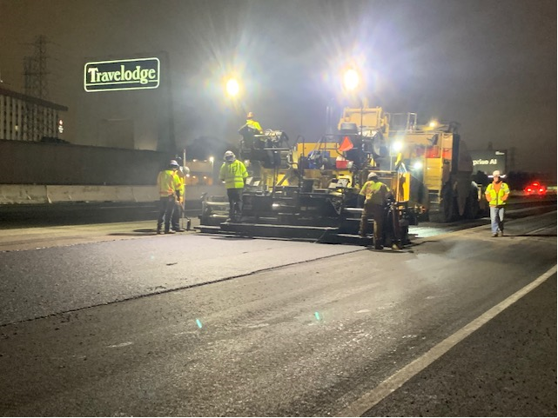
NORTH CONTRACT WORK ONGOING
Final Layer (1/10th Overlay) Paving

Slide 14
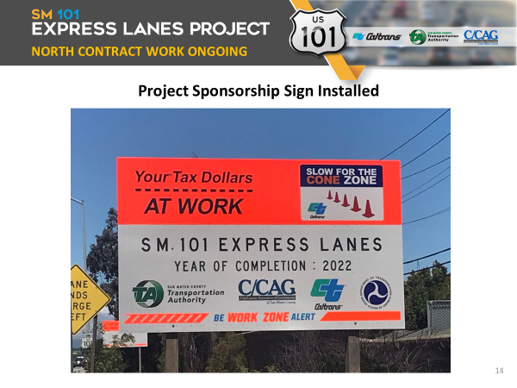
NORTH CONTRACT WORK ONGOING

Slide 15
UPCOMING WORK: October - December
North of Whipple:
Final layer (1/10th) overlay paving – finishing in Block 1
Constructing, texturing, and painting median barrier
Installing sign structures and variable toll message signs in all Blocks
Installing tolling equipment in Block 4 (TransCore)
Completing fiber optic cable connections to Millbrae BART Station

Slide 16
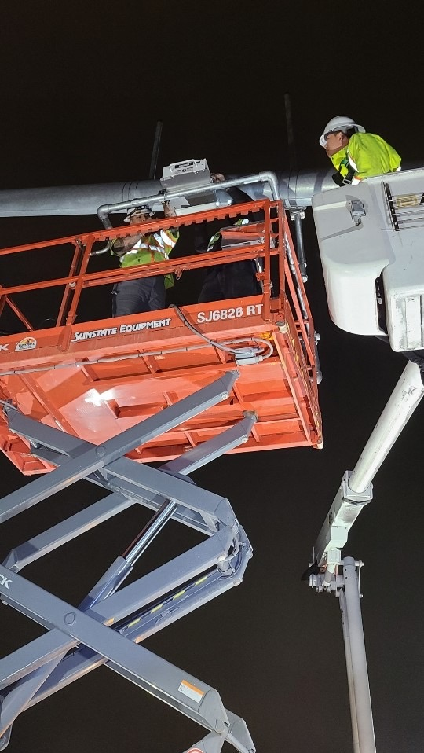
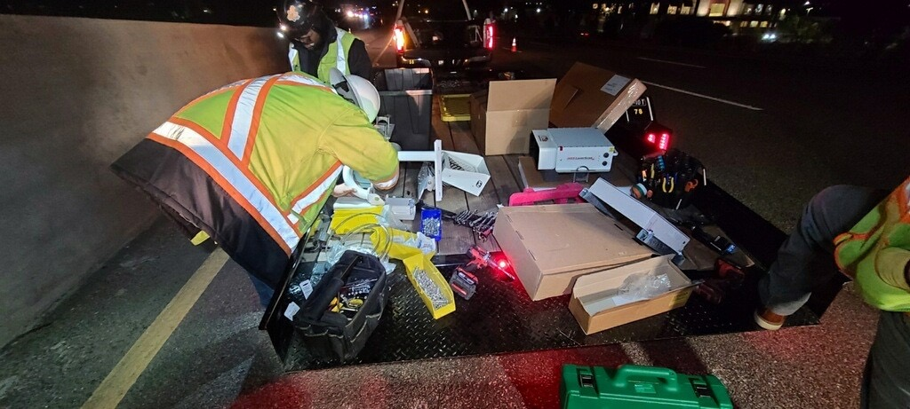
SOUTH CONTRACT WORK COMPLETED
South of Whipple
through September:
Completed installation of tolling equipment

Slide 17
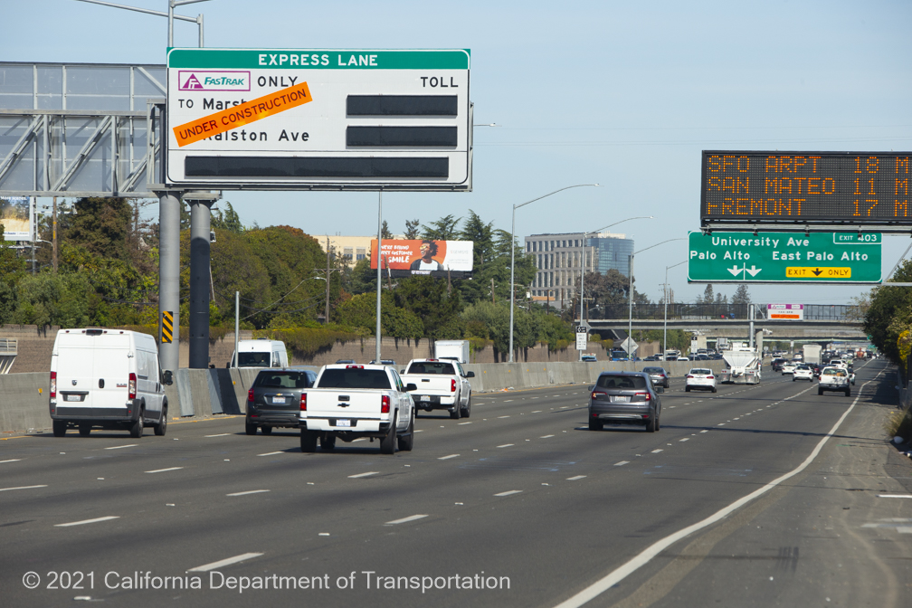
UPCOMING WORK: October – December
South of Whipple:
Testing tolling equipment and system
Restriping freeway to final express lanes configuration
Installing variable toll message sign overlays
Installing other median signage

Slide 18
  Construction Progress
  Project Spotlight
  Public Outreach Activities
  Financial and Risk Status

Slide 19
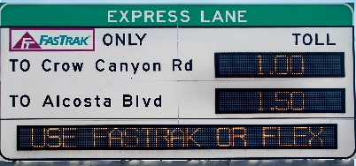
LANE OPERATING MODES DURING TRANSITION
TOLL TESTING
Marsh Rd
Ralston Ave
HOV 2+ ONLY
XXX
Marsh Rd
Ralston Ave
0.50
UNDER CONSTRUCTION
XXX
1.50
HOV 3+ NO CHARGE
HOV
EXPRESS LANE IN HOV-ONLY MODE
TOLLING
System Installation
Testing
Express Lane Operations
Present Day
Begin Tolling

Slide 20
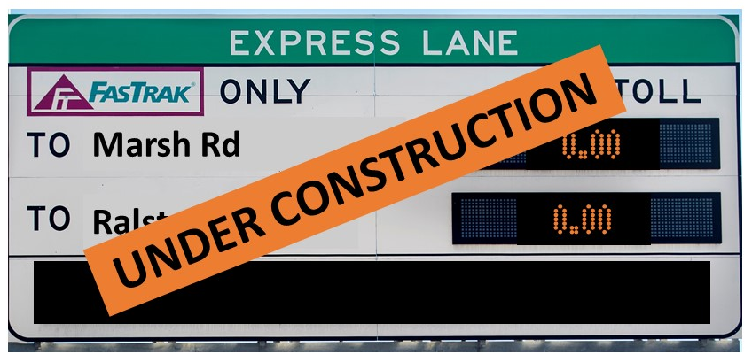
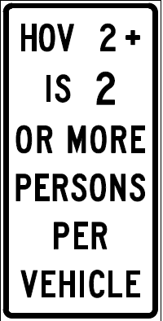
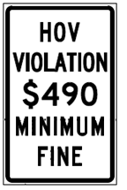
SIGNS DURING CONSTRUCTION
HOV
Variable Toll Message Sign
LEFT
LANE
Other Median Signs
BUSES AND
CARPOOLS
ONLY
5AM – 9AM
3PM – 7PM
MON-FRI

Slide 21
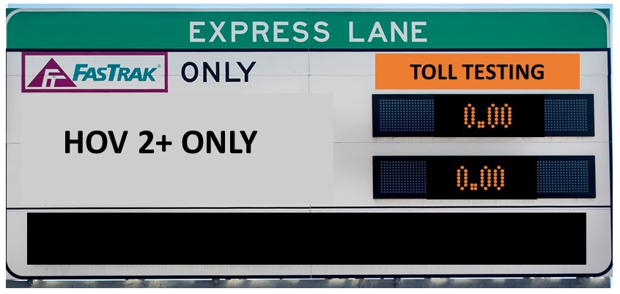
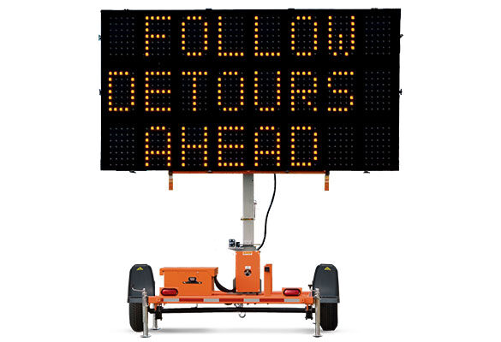
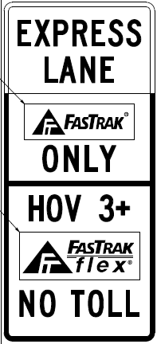
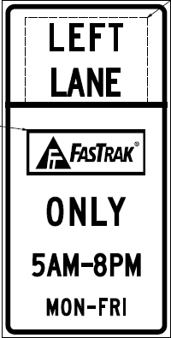
SIGNS DURING TOLL TESTING
EXPRESS LANE IN HOV-ONLY MODE
HOV 2+
5 AM – 9 AM
3 PM – 7 PM
Portable Changeable Message Sign
Variable Toll Message Sign
2+
White overlay covers Express Lane sign
2
Other Median Signs
5AM – 9AM
3PM – 7PM
Mon – Fri

Slide 22
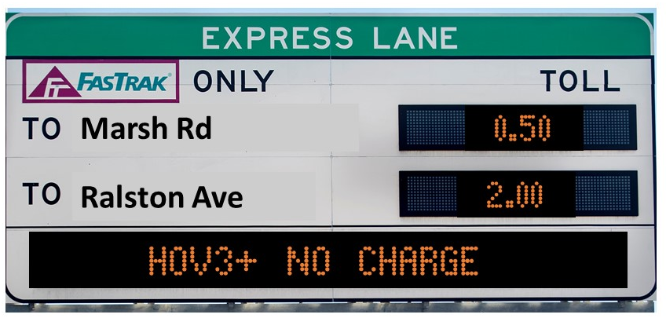


SIGNS AFTER TOLLING BEGINS
TOLLING
Variable Toll Message Sign
Other Median Signs

Slide 23
  Construction Progress
  Construction Spotlight
  Public Outreach Activities
  Financial and Risk Status

Slide 24
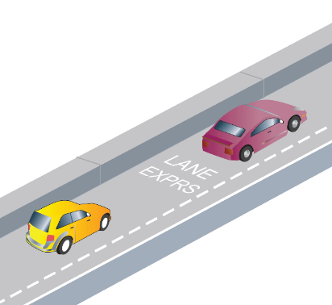
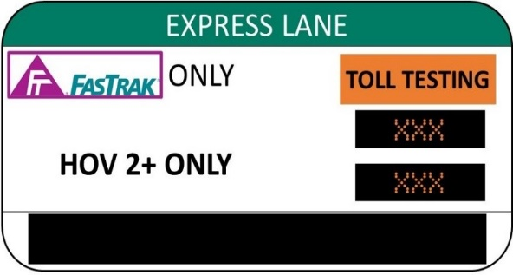
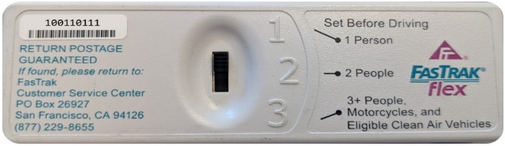
PUBLIC INFORMATION – TOLL TESTING
  Key Messages:
  Express Lanes are opening soon (begin tolling)
  Follow the signs on the road
  Get a FasTrak® Flex or CAV Toll Tag now
  Outreach Tools:
  Quarterly Email
  Updated Caltrans project website (Main page, FAQs, Factsheet)
  Social Media (Twitter and Facebook)
  Traffic Advisory (for media)
  Portable Changeable Message Signs

Slide 25

TIMELINE – MARKETING EXPRESS LANE OPENING
  Public Information - 45 days before lane opens (tolling begins)
    On Corridor Signage
    Regional websites (Caltrans, 511.org, FasTrak)
    Social Media Messaging (Partners)
    Press Release (with Caltrans, VTA, MTC)
    Email blast: Cities, Community, Business and Key Stakeholders
  Marketing/Advertising - 30 days before/after lane opens (tolling begins)
    Collaboration with MTC (511.org, FasTrak) and VTA
    Digital/Social
    Radio

Slide 26

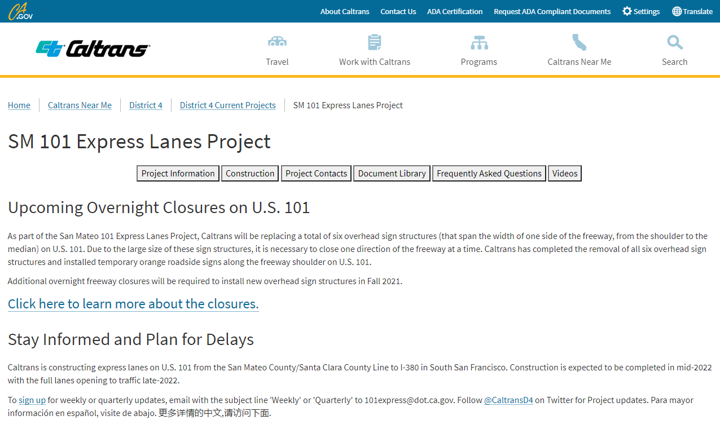
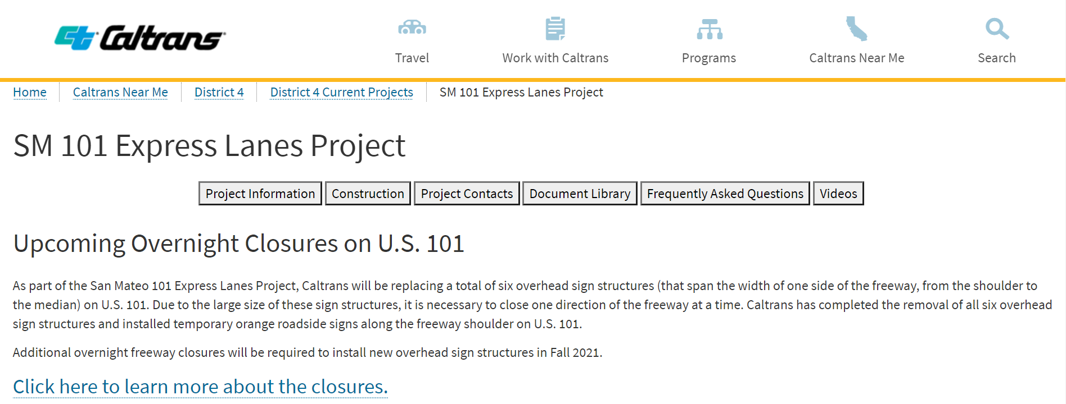
PUBLIC INFORMATION OVERVIEW
  101Express.com
  Construction updates are distributed via email.
  Visitors can sign up for updates, contact Caltrans to ask a question, and view project status.
  To sign up for weekly or quarterly updates, email with the subject line 'Weekly' or 'Quarterly' to 101express@dot.ca.gov. Follow @CaltransD4 on Twitter for Project updates.
Notes:
Weekly construction information, including ramp closure details, emailed to those signed up on the project email list
Ramp closure notification posted on ramps up to two weeks in advance of closures
Quarterly “newsletter” distributed via email to Elected Officials, City Officials, etc.
Focused information to cities/jurisdictions to distribute as requested

Slide 27
  Construction Progress
  Project Spotlight
  Public Outreach Activities
  Financial and Risk Status

Slide 28
CURRENT COST ESTIMATE - CONTRACT FOCUSED
(1) Estimated Cost represents current estimated cost to complete each contract.
(2) Expenditures include $12M deposit against North Contract – Civil.
(3) Percent completes shown are based on qualitative assessment of physical % complete per milestones and schedule.
(4) Å = Within budget, Å = identified potential risks that may significantly exceed budget if not mitigated,
Å = Known impacts to budget - changes forthcoming.
Assume 100% utilization of Project Contingency in overall estimated cost of project

Slide 29
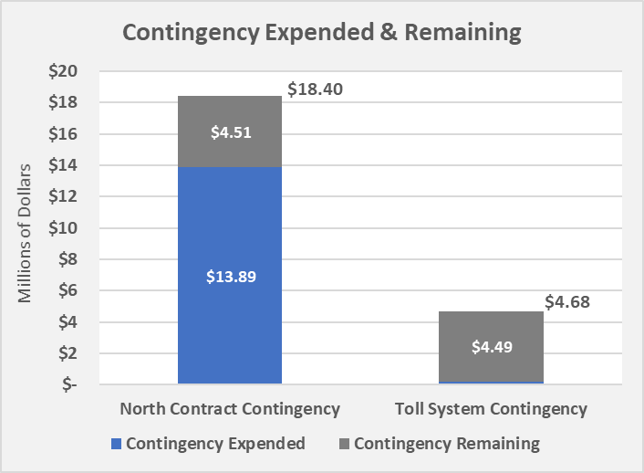
CURRENT CONTINGENCY BALANCE
$0.19
Contingency expended includes the following:
  New contract change orders for various reasons including, barrier foundation revisions, grade revisions, maintenance of landscape areas, and miscellaneous signage issues

Slide 30




RISK MANAGEMENT – CIVIL CONTRACT
18.16
5.14

Slide 31
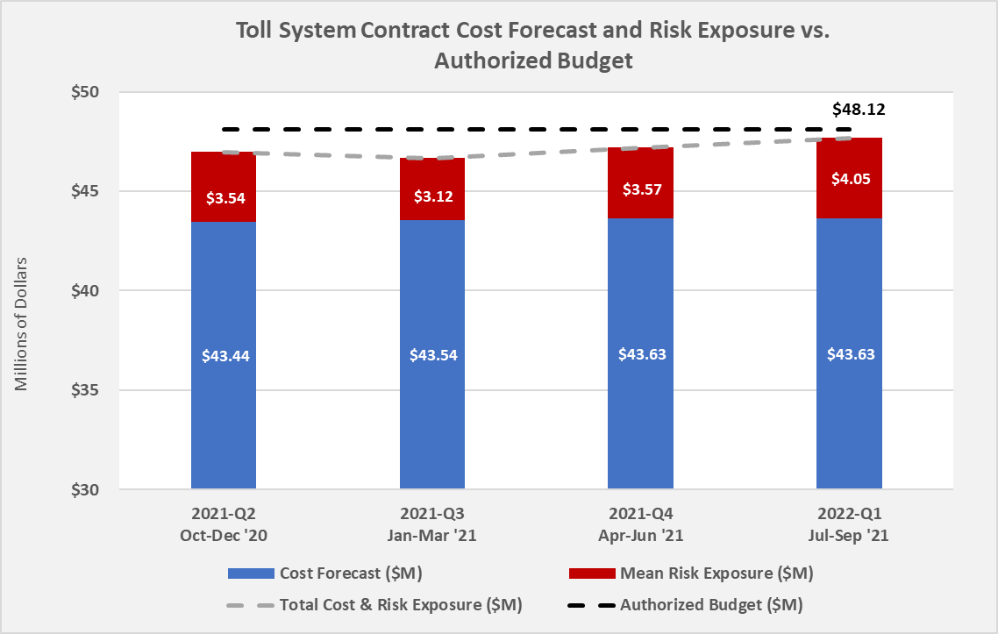
RISK MANAGEMENT – TOLL CONTRACT

Slide 32
Questions?

